Slide 1
Assembly Automation
Mike Mathis, Senior Software Engineer, Siemens PLM Software

Slide 2
Agenda
The task
Considered approaches
The solution
Code it up!

Slide 3
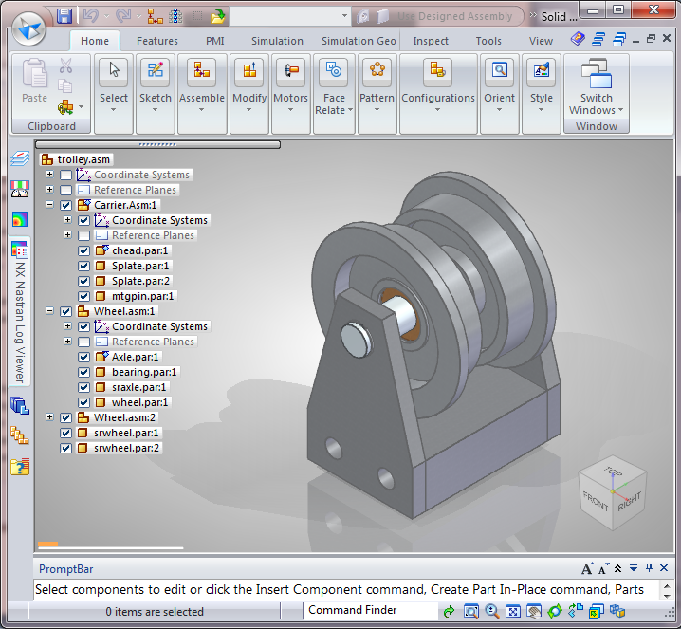
The germ of an idea
Notes:
Problem: Need to make a copy of a test case before I rip into it.

Slide 4
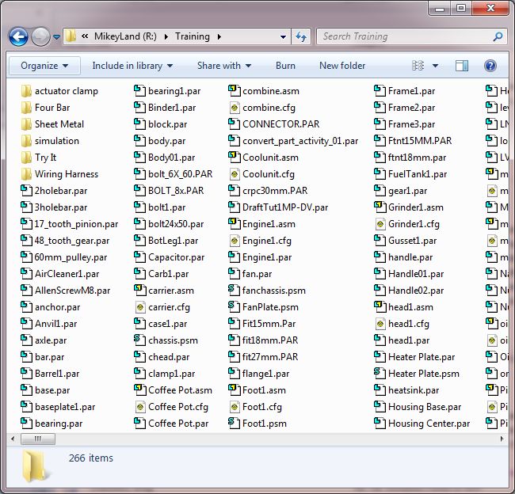
Copy In Windows Explorer
Notes:
Easy if all in a single folder, but what if: single branch of a subassembly? which files? Multiple folders?

Slide 5
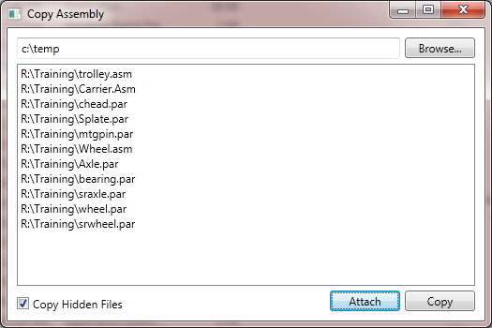
Here’s what I need!

Slide 6
Requirements?
Identify an assembly
Determine its component files
Identify a target folder
Copy the files
Notes:
File Open dialog. 3. Find Folder dialog. 4. Use Windows APIs. All easy.
Crack the file on disk, extract the link information, resolve the absolute or relative monikers to filenames, and repeat all the way through the assembly. Huh?

Slide 7
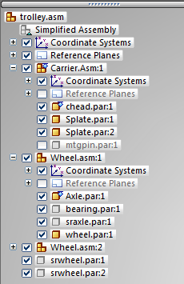
Determine assembly’s component files
Use Solid Edge!
Open the assembly in SE, then use the published APIs to traverse the assembly and extract the filenames.
Bonus: Specialize the process to consider things like show/hide.

Slide 8
Code it up!

Slide 9
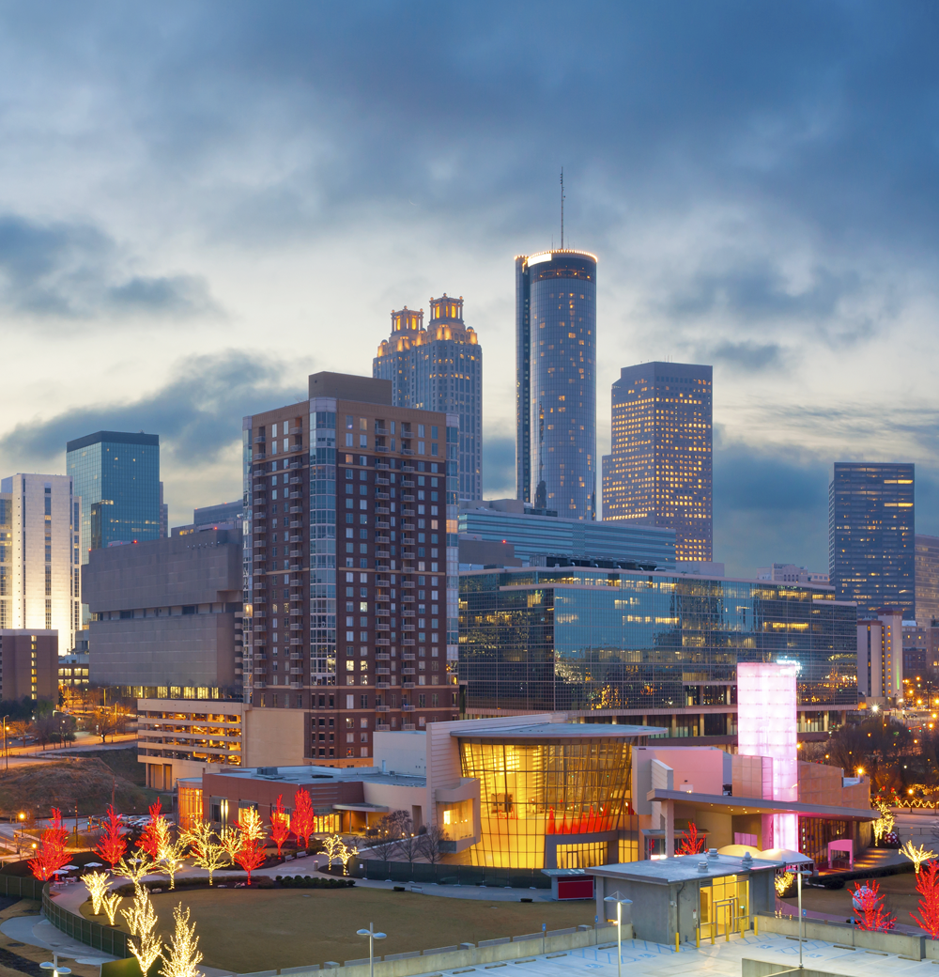
Contact, Arial Bold 20 pt
Mike Mathis Senior Software Engineer Solid Edge Assembly Development
675 Discovery Drive Suite 100 Huntsville, Alabama 35806 USA
Phone: 256-705-2566 E-mail: mike.mathis@siemens.com

Slide 10
Allowable design space
Optional background colors for boxes:
With title bar or without...bar can use blue, grey or orange colors
205 | 230 | 235
140 | 195 | 210
85 | 160 | 185
215 | 215 | 205
170 | 170 | 150
190 | 205 | 215
135 | 155 | 170
35 | 55| 70

Slide 11
Siemens color palette Web and presentation colors (RGB)
Primary colors | RGB-values
Accent colors | RGB-values
Special web colors
0 | 153 | 153
235 | 120 | 10
238 | 238 | 238
255 | 185 | 0
153 | 0 | 0
255 | 255 | 255
100 | 25 | 70
0 | 0 | 0
175 | 35 | 95
135 | 155 | 170
0 | 100 | 135
85 | 160 | 185
190 | 205 | 215
100 | 125 | 45
170 | 180 | 20
170 | 170 | 150*
15 | 25 | 35
80 | 90 | 100
215 | 215 | 205
* Siemens Sand is only permitted at full saturation in type.

Slide 12
Siemens color palette GUI colors (RGB)
35 | 55 | 70
60 | 55 | 45
125 | 45 | 30
65 | 20 | 50
0 | 55 | 75
55 | 80 | 15
5 | 10 | 15
55 | 75 | 90
90 | 85 | 75
160 | 60 | 35
80 | 20 | 60
0 | 70 | 100
70 | 95 | 25
15 | 25 | 35
80 | 100 | 115
110 | 105 | 90
180 | 75 | 40
100 | 25 | 70
0 | 85 | 120
85 | 110 | 40
30 | 40 | 50
100 | 120 | 135
130 | 127 | 110
200 | 90 | 30
120 | 30 | 75
0 | 100 | 135
100 | 125 | 45
50 | 60 | 70
115 | 135 | 150
150 | 150 | 130
220 | 105 | 20
135 | 30 | 80
20 | 115 | 145
115 | 135 | 50
65 | 75 | 85
135 | 155 | 170
170 | 170 | 150
235 | 120 | 10
155 | 30 | 90
40 | 130 | 160
135 | 150 | 40
80 | 90 | 100
155 | 175 | 190
185 | 185 | 165
245 | 140 | 20
175 | 35 | 95
60 | 145 | 175
150 | 165 | 30
100 | 110 | 120
173 | 190 | 203
200 | 200 | 185
250 | 165 | 10
195 | 70 | 115
85 | 160 | 185
170 | 180 | 20
125 | 135 | 145
190 | 205 | 215
215 | 215 | 205
255 | 185 | 0
215 | 105 | 140
115 | 180 | 200
190 | 195 | 40
150 | 160 | 170
205 | 217 | 225
225 | 225 | 215
255 | 205 | 80
230 | 135 | 165
140 | 195 | 210
210 | 215 | 65
175 | 185 | 195
223 | 230 | 237
235 | 235 | 227
255 | 225 | 120
240 | 170 | 195
175 | 215 | 225
230 | 230 | 95
200 | 210 | 215
235 | 240 | 245
245 | 245 | 240
255 | 240 | 155
245 | 200 | 220
205 | 230 | 235
240 | 240 | 140
220 | 225 | 230

